Slide 1
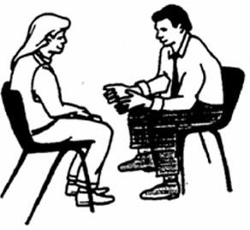
GUIDANCE AND COUNSELLING
Presented By
Ramesh Chandra Mahato

Slide 2
INTRODUCTION
Guidance & counselling are twin concepts & have emerged as essential elements of every educational activity.
Guidance & counselling are not synonymous term. Counselling is a part of guidance.
Guidance, in educational context, means to indicate, point out, show the way, lead out & direct.
Counselling is a specialized service of guidance. It is the process of helping individuals learn more about themselves & their present & possible future situations to make a substantial contribution to the society.
2

Slide 3
DEFINITION OF GUIDANCE
Guidance is an assistance made available by a competent counselor to an individual of any age to help him direct his own life, develop his own point of view, make his own decision & carry his own burden.
- Hamrin & Erikson
Guidance is a process of helping every individual, through his own effort to discover & develop his potentialities for his personal happiness & social usefulness.
- Ruth Strang
3

Slide 4
DEFINITION OF COUNSELLING
Counseling is essentially a process in which the counselor assists the counselee to make interpretations of facts relating to a choice, plan or adjustment which he needs to make.
- Glenn F. Smith
Counseling is a series of direct contacts with the individual which aims to offer him assistance in changing his attitude & behaviors.
- Carl Rogers
4

Slide 5
DIFFERENCE BETWEEN GUIDANCE AND COUNSELLING
GUIDANCE | COUNSELLING
Guidance is broader & comprehensive | Counselling is in-depth & narrow
Guidance is more external, helps a person understand alternative solutions available to him & makes him understand his personality & choose the right solution. | Counselling helps people understand themselves & is an inward analysis.Alternative solutions are proposed to help understand the problem at hand.
Guidance is mainly preventive & developmental | Counselling is remedial as well as preventive & developmental
5
www.drjayeshpatidar.blogspot.com

Slide 6
DIFFERENCE BETWEEN GUIDANCE AND COUNSELLING
GUIDANCE | COUNSELLING
Intellectual attitudes are the raw material of guidance | Emotional rather than pure intellectual attitude are raw material of the counselling process.
Decision making is operable at an intellectual level in guidance | Counselling operates at an emotional level
Guidance is generally education & career related & may also be for personal Problems. | Counselling is mostly offered for personal & social issues.

Slide 7






PURPOSES OF GUIDANCE AND COUNSELLING
Providing the needed information & assistance
Helping in individual to make wise choices
Improve the understanding of self
Facilitate the adjustment
Helps in adapting to the changes or new environment
Making self-sufficient & independent
7

Slide 8






PURPOSES OF GUIDANCE AND COUNSELLING
Efficient use of capabilities & talent
Promote the optimal personal & professional development
Balanced physical, psychological, emotional, social & spiritual growth
Helps in overall development & to live productive life
8

Slide 9
Other functions of guidance and counselling…
To provide optimum development & well-being for individual.
To help individuals adjust to themselves & the society.
To help people understand themselves in relation to the world.
To aid individuals in efficient decision making.
To help individuals plan for a productive life in their social context by focusing on their assets, skills, strengths & possibilities for further development.
To bring about changes in the attitude & behavior of individuals.
9

Slide 10
CHARACTERISTICS OF GUIDANCE
It is process
It is a continuous process
Choice & problem points are the distinctive concerns of guidance
It is the assistance to the individual in the process of development rather than a direction of that development
Guidance is a service meant for all Guidance is both generalized & a specialized
service

Slide 11
Count…
Guidance is an organized service & not an incidental activity of the school.
Guidance is not a branch of any discipline Guidance bas limits
Guidance is more an art than science Guidance bas its roots in the education system
Guidance is centered around the needs & aspirations of students.

Slide 12
CHARACTERISTS OF COUNSELLING
Counselling involves two individuals-one seeking help & the other a professionally trained person who can help the first.
There should be a relationship of mutual respect between the two individuals.
Counselling is aimed at bringing about desired changes in the individual for self-realisation & providing assistance to solve problems through an intimate personal relationship.
The counselor discovers the problems of the counselee & help him to set up realistic goals

Slide 13
Count…
If counselee is a student, counselling helps him to take a decision, make a choice or find a direction in matters related to an educational programme or career.
It helps the counselee acquire independence & develop a sense of responsibility.
It is more than advice giving.
It involves something more than offering an assistance to find a solution to an immediate problems.
Counselling is democratic.
Counselling concerns itself with attitudes as well as actions Counselling is centered around the needs & aspirations of students

Slide 14









SCOPE OF GUIDANCE AND COUNSELLING
Guidance & counselling for personal needs/problems
Guidance & counselling for educational needs/problems
Guidance & counselling for physical, emotional, social, moral & marital problems
Guidance & counselling for vocational, occupational & professional needs
Guidance & counselling for career advancement Guidance &
counselling for holistic individual development
Guidance & Counselling for Situational Problems
14

Slide 15
NEED OF GUIDANCE AND COUNSELLING
I. Need s for personal & social domain
Personal & social development of individual
To adapt in different stages of development
Offering art of better living
Proper use of leisure time
Holistic personality development
Best use of available opportunities
Motivates for effective utilization & development of self

Slide 16
NEED OF GUIDANCE AND COUNSELLING
II. Needs for educational/professional domain
Helps in academic growth & development
Helps in vocational & professional maturity
Facilitates an individual in the right education & profession
Offer help to handle educational & professional situations
Helps in the proper utilization of human resources
Helps in adapting to the changing concept of education
Prepares to adapt in changing professional situations & emerging challenges
Helps in making proper career choice
Helps to minimize indiscipline

Slide 17
Need of Guidance and Counselling in Nursing Education…
To help students adjusting with the new environment of the nursing institute.
To help in developing qualities required for a successful for a nursing practice.
To help students in getting adjusted with the clinical environment.
To help students keeping in touch with the latest trends in nursing
To help students in developing positive learning habits, especially skill learning
To help in the development of appropriate coping straggles in
order to deal with stress in a productive manner

Slide 18
Need of Guidance and Counselling in Nursing Education…
To help nursing students in establishing proper identity.
To help them to develop a positive attitude towards life.
To help to overcome periods of turmoil & confusion.
To help students in developing their leadership qualities.
To motivate them for taking membership in professional organizations after competing their studies.
Helps them to make advantages of technological advancement in a patient care.
Helps them to readiness for changes & face challenges
To carryout responsibilities as a health team member
Helps them to proper selection of career
Motivate them for higher studies.

Slide 19

FUNCTIONS OF GUIDANCE AND COUNSELLLING
Adjustmental
Developmental
Orientation

Slide 20
PRINCIPLES OF GUIDANCE
According to Crow and Crow:
All-round development of individuals Principles of individual differences Guidance is related to every aspect of life Cooperating among persons
Guidance is a continuous & lifelong process Guidance for all
Principles of elaboration Responsibility of teachers & parents Flexibility
Principles of evaluation Guidance by a trained person
Principle of periodic appraisal

Slide 21
PRINCIPLES OF GUIDANCE
According to Hollies and Hollies:
The dignity of the individual is supreme.
Each individual is different from every other individual.
The primary concern of guidance is the individual, in his social setting.
The attitude & personal perceptions of the individual are the basis on which he acts.
The individual generally acts to enhance his perceived self. The individual has the innate ability to learn.
the individual needs a continuous guidance process from early
childhood through adulthood.
Each individual may need the information & personalized assistance
given by competent professional personnel at some time.

Slide 22
TYPES/AREAS OF GUIDANCE SERVICES
Personal
guidance
Avocational guidance
Social guidance
Types of Guidance Services
Health
guidance
Educationa
l guidance
Vocational guidance

Slide 23
ORGANIZATION OF COUNSELLING SERVICES
Types or forms of the organization of counselling services in educational institutions are:
  Centralization counselling services:
(The entire responsibilities of the guidance
& counselling services is vested upon a group of trained personnel of the department of guidance & counselling services )
II. Decentralization counselling services:
(The responsibilities of the counselling services is vested upon teachers
III. Combination of centralized &
decentralized counselling services:
(In this mixed form, guidance & counselling
services are provided by teachers &
expert collectively.)

Slide 24
Purposes of organization counselling services…
To help individuals with normal development problems.
To help individuals through a temporary crisis during the different stages of life.
To identify signs of disturbed behavior at early stage, so manage it.
To refer critical cases to specialists for best possible management.
To facilitate communication within & between nursing institutions & homes.
To support not only the tutors/nursing faculty who are helping individuals but also who themselves want guidance &
reassurance at times.

Slide 25




Ingredients of guidance and counseling services…
1. The Admission Service
(Admitting the right candidates
for the right course, selecting those candidates most likely)
2.The Orientation Service
(A “welcome service” as it is concerned with welcoming fresher's to the world of
nursing )
3.The Student Information
Service
(Assist the student to obtain a realistic picture of his
abilities, interests, personality characteristics , achievements, levels of aspiration , state of health, etc.)
4.The Information Service
(Information provide usually related to Education,
occupational & personal-
social )

Slide 26




Ingredients of guidance and counseling services…
6.The Placement Service
(Help students to be in proper scholastic track, to realize their career expectations, organize campus selection
interviews, provide information regarding current trends, etc. )
8.The follow-up Service
(it is that review or systematic evaluation which is carried out to find out whether
guidance services in particular & educational programme in general satisfies the needs of the students. )
5.The Counselling Service (understand what he can do & what he should do, handle
his difficulties in a rational way, make his own decision, etc.)
7.The Remedial Service
(it is mainly oriented towards
helping students to improve their study habits, improve their adjustment in the clinical area, reducing stress, etc.)

Slide 27


Ingredients of guidance and counseling services…
10.The Evaluation Service (it determines the effectiveness & efficiency of the guidance programme, less number of
dropouts, harmonious relationship between teachers & students, good result, well placed passed out students, sense of security, etc. )
9.The Research Service
(It is intended to examine both the personnel in the college guidance programme & the techniques of guidance used by them so as to discover their strong & weak points & ultimately strengthen the
whole programme .)

Slide 28

Basic components of Counselling services…
Organizational set-up
Requirement of counselling services
Counselling
centre
Tools for counselling services
Counselling committee

Slide 29



Organizational set-up…
For constituent colleges:
A counselling officer assisted by the guidance committee in cooperation with the deputy chief & academic advisor can plan according to their needs & number of students. (<1000 students need a liaison officer while >1000 students need an assistant counselling officer .)
At universities: Deans are assisted by head of departments of psychology & education, the guidance committee
& counselling officer.
For affiliated colleges:
A counselling officer assisted by the guidance committee & a vocational guidance officer are needed for > 1000 students while a liaison officer only can manage the counselling services for <1000 students

Slide 30
Counselling centre…
All universities & large colleges should have a counselling centre headed by a trained professional, i.e, a counselling officer with PhD or a master’s degree in psychology & counselling, with considerable experience. It perform following functions:
Physical & psychological
Selection, registration & orientation of students
Educational & vocational counselling
Personal adjustment counselling
services
Remedial services
Residence & food services
Activities programme

Slide 31
Counselling committee…
The guidance committee serves the following purposes:
It establishes & maintains policies related to guidance & counselling services.
It articulates the programme between the institution & the community.
It act in a planning capacity to ensure that the various functions of guidance are properly coordinated.
It helps to clarify particular roles & offers support when these roles are challenged.
It serves as a source of ideas & recommendations to be submitted to appropriate bodies.

Slide 32
Count…
Members of the counseling committee:
Administrator
principal/Dean
Counselling/Liaison officer
Deputy chief of counselling section
Counselling personnel/ Counselor
Vocational guidance officer
Teacher/Faculty from different department/ Specialties
Hostel warden/ Librarian
Students representatives
Parents

Slide 33

Tools for counselling services…
I. Nontesting tools
II. Psychological tests

Slide 34
Tools for counselling services…
I. Nontesting tools
Interview
It is an interaction between the counsellor & counselee with a definite
objective in mind
Cumulative record
It is a method of recording
& providing meaningful, significant & comprehensive information about an individual, over a year.
Sociometry
Observation
It is careful watching or
monitoring of the counselee by the counsellor with a specific objective in mind
Checklist
A is used to identify the presence or absence of
specific attributes or
skills of a particular expected behavior in students.
Anecdotal record
It consists of recording
an important incident that happened & is a carefully recorded snapshot of the incident
Rating Scale
It is better tools to
assess the degree or extent of the performance of a particular task or the possession of a trait.
It is used to measure sociability or the social
Autobiography & diary
It may also provide useful
distance between students or members of a
information about students.
34 www.drjayeshpatidar.blogspot.com 9/20/2013
group

Slide 35





Tools for counselling services…
II. Psychological tests
Achievement tests
Eg; Cooperative test, College Board series, English reading test
Personality
tests
Eg; The Rorschach &
The Minnesota
Aptitude tests Eg; Specialize aptitude test & General aptitude
test
Interest inventory tests Eg; Blank and Kuder preference inventory
Study habit inventory tests Eg; The Brown- Holtzman survey of study habit
www.drjayeshpatidar.blogspot.com

Slide 36
Specific requirements for the organization of counselling services…
Presence of physical facilities, i.e. rooms, furniture & other equipment needed for the guidance & counselling department.
Provide of private officers as well as general counselling rooms.
Trained counsellor & guidance personnel Planned programmes to meet objectives Consultation services
Evaluation instruments like psychological tests, inventories, etc.

Slide 37
Student data bank
Educational & vocational information services Programmes for integrating community services with guidance services
Specific requirements for the organization of counselling services…
Educational programmes for teachers, counselors & other personnel to provide knowledge of current trends in guidance
Budgetary provisions

Slide 38




TYPES OF COUNSELLING APPROACHES
Electic counselling approach
Nondirective counselling approach
Directive counselling approach

Slide 39
I. Directive Counselling Approach
It is also known as prescriptive counselling or counsellor-centred approach of counselling.
This approach of counselling is advocated by E.G.Williamson, a professor at University of Minnesota.
In directive counselling, the counsellor plays a leading role & uses a variety of techniques to suggest appropriate solutions to the counselee's problem.
This approach also known as authoritarian or psychoanalytic approach.
The counsellor is active & help individuals in making decisions & finding solution to their problems.
The counsellor believes in the limited capacity of the patient.

Slide 40

I. Directive Counselling Approach
Count…
The patient makes the decision but the counsellor does all he can to get the patient make decision keeping with his diagnosis.
The counsellor tries to direct the patient’s thinking by informing, explaining, interpreting & advising.
The basic assumptions related to directive counselling approach:
Making the
Problem focused rather than patient focused approach
Used for patients incapable of solving their problems
best possible use of counselee's intellectual abilities & resources
A need- based approach
Task of a competent counsellor

Slide 41
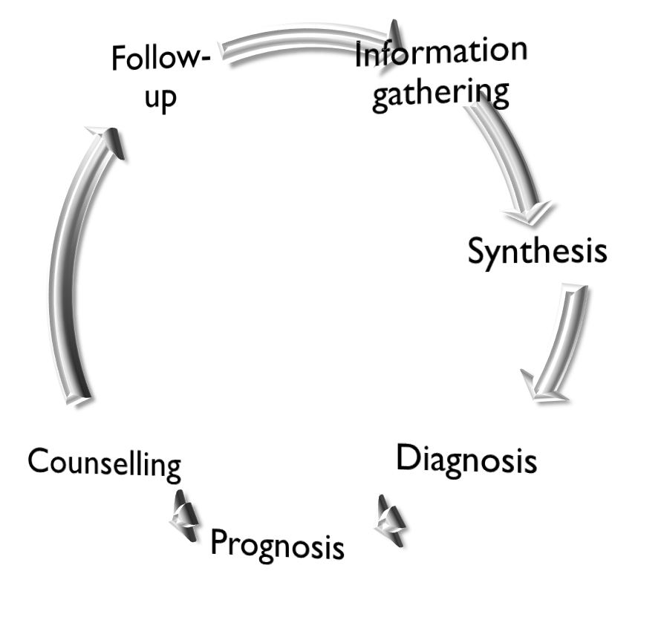
I. Directive Counselling Approach
Count…
Steps of the directive counselling approach
E.G.Williamson has given the following six steps in providing directive counselling

Slide 42
I. Directive Counselling Approach
Count…
Advantages of the directive counselling approach
This approach save time.
It emphasizes the problem & not the individual.The counsellor can see the patient more objectively than the patient himself.
It lays more emphasis on the intellectual rather than the emotional aspects of an individual’s personality.
The methods used in directive counselling are direct, persuasive & explanatory.

Slide 43
I. Directive Counselling Approach
Count…
Limitations of the directive counselling approach
The patient does not gain any liability for self analysis or solve new problems of adjustment by counselling.
It makes the counselee overdependent on the counsellor.
Problems regarding emotional maladjustment may be better solved by nondirective counselling.
Sometimes the counselee lacks information regarding the counselee, leads wrong counselling.
It does not guarantee that the counselee will able to solve the same problem on his own in future.

Slide 44
II. Nondirective Counselling Approach
The chief exponent of this counselling approach, Carp R.
It is also known as the permissive counselling approach where the counselor's role is passive & the counselee’s role is active.
It is a counselee-centred or patient-centred humanistic approach.
The counselee makes the final decisions as individuals are thoughts to have full right to make final decisions for the self & solve their problems.
The counsellor has to accept the counselee’s capacity to make adjustment & adapt.

Slide 45
II. Nondirective Counselling Approach
count…
The principles of acceptance & tolerance are extremely important in this approach.
The basic assumptions related to nondirective counselling approach are:
Patient is given importance than the counselling directions & investigations
Emotional aspects are more significant than intellectual aspects.
Creation of an atmosphere where patients can work out their understanding is more important than cultivating self- understanding in the patient.
Counselling leads to a voluntary choice of goals & a conscious selection of courses of action.

Slide 46


II. Nondirective Counselling Approach
count…
Steps of the nondirective counselling approach
Carp R. Rogers given five steps in nondirective counselling:
Defining the
problem situation
Termination of
counselling
Counselee given freedom to express his feeling

Slide 47
II. Nondirective Counselling Approach
count…
Advantages of nondirective counselling approach
It is a slow but sure process to make an individual capable of making adjustments.
No tests are used so one avoids all that is laborious & difficult .
It removes emotional block & helps an individual bring repressed thoughts on a conscious level thereby reducing tension.

Slide 48
II. Nondirective Counselling Approach
count…
Limitations of nondirective counselling approach
It is a slow & time-consuming process.
One cannot rely upon one’s resources, judgment & wisdom as the patient is immature in making the decision himself.
It depends too much on the ability & initiative of the patient.
Sometime difficulty to control pace of the interview discussion.
This approach is individual centric, it may not possible for counsellor to attend every patient equally well.
It require high degree of motivation in the patient.

Slide 49
III. Eclectic Counselling Approach
This approach is based on the fact that all individuals are different from one another.
The techniques are elective in nature because they have been derived from all sources of counselling.
This approach is based on selecting the best & leaving out what is least required.
The basic assumption related to eclectic counselling approach:
There is objectivity & co-ordination between counsellor & the patient during the counselling experience.
The patient is active & the counsellor remains passive in the beginning.

Slide 50
III. Eclectic Counselling Approach
count…
The principle of low expenditure is adopted.
The counsellor makes use of all the tools & methods in his armour.
The counsellor enjoys the freedom to resort to directive & nondirective counselling methods.
The counselling relationship is built during the counselling interview. This helps the patient gain reassurance & confidence.

Slide 51






III. Eclectic Counselling Approach
count…
Steps of the eclectic counselling approach
Establishing
rapport
Follow- up
Diagnosis the problem
Counselling
Analyzing the case
Preparing a tentative plan for modifying
behavior

Slide 52
III. Eclectic Counselling Approach
count…
Advantages of eclectic counselling approach
It is more cost effective & practical approach.
It is a more flexible approach of counselling.
It is more objective & coordinated approach of counselling.
Limitations of eclectic counselling approach
The role of counsellor & the counselee are not predetermined.
It requires more skilled counselors to handle the dynamic feature of this counselling approach.

Slide 53
IV. Other types of counselling
Based on length of the counselling session:
  Short-term counselling
  Long-term counselling
Based on number of counselees involved:
  Individual counselling
  Group counselling

Slide 54
IV. Other types of counselling
count…
C) Counselling for educational & professional purposes:
Student counselling
Educational counselling Vocational counselling Career counselling Placement counselling

Slide 55








IV. Other types of counselling
count…
D) Counselling for health-related purposes:
Psychotherapeutic counselling
Crisis
counselling
Health
counselling
Genetic
counselling
E) Counselling for personal/social purposes:
Personal
counselling
Marriage
counselling
Motivational
counselling
Developmental
counselling

Slide 56
ROLE OF THE COUNSELLOR
Arrange orientation programmes for the other support staff to enlist their cooperation.
Prepare an up-to-date list of resources, information, referral & energy available to him.
Organize the guidance committee.
Set up an educational & occupational information centre.
Display the information collected in an attractive way.
Disseminate information through educational & career talks, group discussion & so on.
Arrange talks by expert from different fields.
Organize career days, career weeks, career conferences, parents day & so on.

Slide 57
Count…
Educate students regarding proper study habits & assist them in their development.
Arrange individual discussion with students & their parents for giving them educational & occupational information.
Arrange visits to place of work like industries, business, establishments, offices, higher education institutions & other important educational places.
Maintain an active relationship with schools, colleges, universities.
Maintain an active liaison with club like Lions Club & Rotary Club.
Refer serious mental cases to clinical psychologist or psychiatrists.

Slide 58
Count…
Maintain complete secrecy of the discussion between him & the patient.
Administer psychological tests.
Provide counselling services to students.
Help in the student placements.
Take up research projecting relating to the fields of educational, vocational, personal & social guidance in colleges.

Slide 59
Qualities of a Good Counsellor…
G – Good technical knowledge
O – Obtaining appropriate information from the patient
O – Objectively answering questions
D – Demonstrating professionalism
C – Confidentiality maintenance
O – Observant
U – Unbiased
N – Nonjudgmental
S – Sensitive to the needs of the patient
E – Empathetic
L – Listens carefully
L – Lets the patient make decisions
O – Open minded
R – Respects the rights of the patients

Slide 60
PREPARATION OF COUNSELLOR
Components of preparation of counsellor:
Experience
(at least 2years of counselling experience, 3-6 months of supervised counselling experiences)
Educational Background (master’s or bachelor’s degree in teaching & education with training in behavioral science )
Personal fitness & attributes (should show positive interest in working with others)

Slide 61
Characteristics or qualities of counsellor…
Personal characteristics:
Should be imbibed with basic human qualities.
Should be a person with cultural values & awareness.
Should have a deep interest in helping people.
Should patiently listen to others
Should be sensitive to other’s attitude & reactions
Should have a capability for being trusted by others.
Should have respect for the personal autonomy of the patients.
Should be tolerate of & accept the patient point of view.

Slide 62
Characteristics or qualities of counsellor…
Interpersonal relationships:
Friendly nature
Sympathetic understanding
Sincerity
Tactfulness
Patience
Ability to maintain confidentiality
Attentive listener
Show concern
Personal adjustment:
Maintain emotional stability
Emotionally sound & healthy
Able to accept criticism
Knowledge of self
Patience
Scholastic potentialities:
Relevant knowledge
Motivated & committed
Aware of policies, beliefs, misconception & rumors in community
Possess common
sense
Good judgment

Slide 63
Characteristics or qualities of counsellor…
Health & personal appearance:
Pleasing voice & appearance
Vitality & endurance
Free from any mannerism
Leadership skills:
Ability to stimulate
Reinforce important information
Direct the counselee to ways to solve the problem
Philosophy of life:
Good character
Integrated personality
Faith in human values
Professional dedication:
Show enthusiasm
Maintain helping relationship
Have a nice sense of morality

Slide 64
COUNSELLING PROCESS
Phase I Establishing relationship
Phase II Assessment
Phase III Setting goals
Phase I V intervention
Phase V Termination & follow-up

Slide 65
Phase I: Establishing relationship
It is an ice breaking session during which the counsellor & counselee introduce each other & establish a primary rapport.
Good rapport building provides the respect, trust & sense of psychological comfort to the counsellor- counselee relationship for progression to the counselling process.
Strategies to establish an effective relationship:
Introduce yourself
Being the phase with adequate social skills
Always address the individual by his or her name

Slide 66
Count…
Ensure physical comfort of the counselee & self.
Do not interrupt the individual when he/she is talking.
Listen attentively.
Observe nonverbal communication.

Slide 67
Phase II: assessment
The second phase of counselling is basically a data collection phase, where the counsellor motivates the counselee to provide complete information about the problem.
The type of information collected from counselee like general data, physical data, psychological data, social/environmental data, achievement data, educational & vocational data.
After the collection of information, diagnosis related to the counselee’s behavior is made.
Various tools & techniques used for data collection like intelligence tests, achievement tests, aptitude tests, interest tests, personality tests, questionnaires, interview, observation, autobiography, anecdotal records, rating scale, cumulative
re₆₇cord & case studies.

Slide 68
Phase III: Setting goals
During this third phase of the counselling process, goals are set co-operative by both the counsellor & the counselee.
While setting goals, the counselee’s strengths, weakness, constraints & available resources must be kept under consideration.
The goal could be immediate & ultimate which directs the counsellor & the counselee to further progress in the counselling process.
Effective & reliable goal setting requires following skills in counselors:
Multifaceted knowledge related to the problem of counselee

Slide 69
Count…
Ability to think critically & inference-drawing skills.
Judgment, planning & management skills
Skills to segregate &differentiate the provided information
Ability to each individuals to think critically & realistically
Help the counselee set feasible, reliable & achievable goals

Slide 70
Phase IV: Intervention
This stage of counselling is an operational phase where the counselee is suggested the best possible options for the management of the present problem.
The phase is affected by the counselor's own thoughts about the counselling process.
The intervention will depend on the approach used by the counsellor, the problem & the individual.
The choice of intervention is a process of adaptation & the counsellor should be prepared to change the intervention when the selected intervention does not work.

Slide 71
Phase V: Termination and follow-up
This is the final stage of the counselling process, where counselling comes to an end.
Termination must be planned well ahead so that the counselee may feel comfortable at the departure & gradually able to handle the problem independently.
Some follow-up sessions may be required to help the counselee further to handle the problem independently.

Slide 72
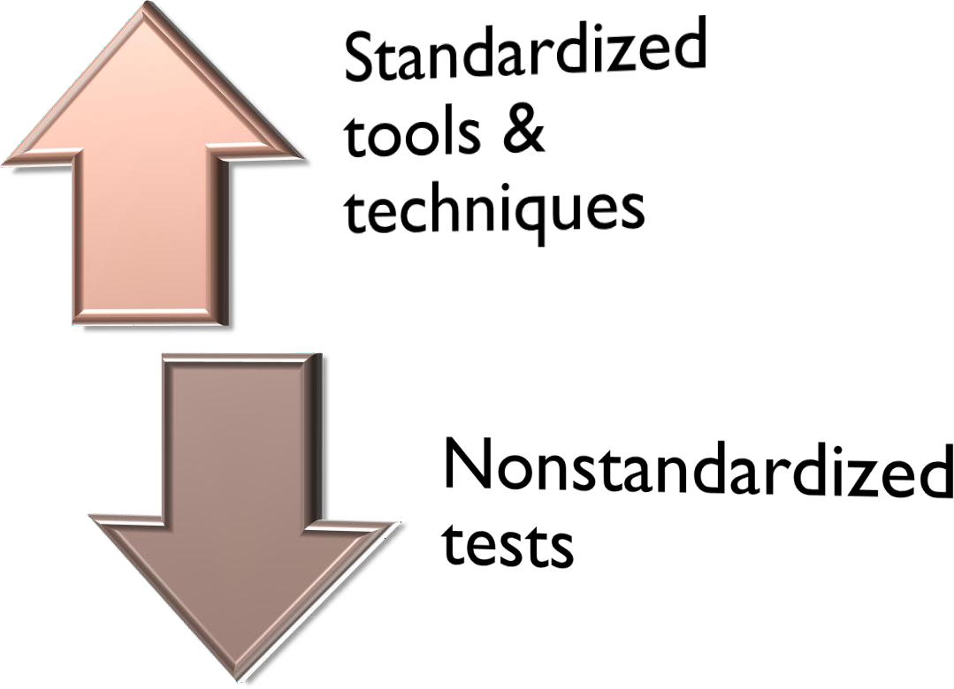
TOOLS AND TECHNIQUES FOR THE COUNSELLING PROCESS
There are two types of tools & techniques for the
counselling process:

Slide 73

Standardized tools and techniques…
Intelligence
tests
Personality
tests
Achievement
test
Standardized tools & techniques
Interest
tests
Aptitude
tests

Slide 74




Nonstandarized tests…
Autobiography Anecdotal records
Questionnaire
Interview
Observation
Cumulative record
Sociometric techniques
Rating scale
Case study
Information collection of information

Slide 75
ISSUES OF COUNSELLING IN NURSING
Scarcity of qualified & competent counselors
Lack of awareness about needs & resources of counselling Minimal procounselling environment
Lack of counselling training for nurse/nursing faculty
Poor organizational set-up for counselling services Lack of interest & initiatives for counselling services
Poor counsellor-counselee ratio Lack of funds for counselling services
Noncompliance with counselling interventions
Ethical & moral Issues

Slide 76
MANAGING DISCIPLINARY PROBLEMS
Common disciplinary problems seen in Indian students are
Absenteeism,
Nonsubmission or late submission of assignments,
Disturbing classroom atmosphere,
Threatening strike,
Damaging or spoiling institutional property,
Picking quarrels over small matters,
Using mobiles phones in the classroom & so on.

Slide 77
Strategies for management of disciplinary problems…
Appropriate training of faculty & teachers
Adequate practice of cocurricular & extracurricular activities
Appropriate selection & use of disciplinary standards
Use reward & punishment
Promoting better teacher-student relationship
Cultivation of ethical, moral & spiritual values
A close teacher-parent-student contact
Effective use og guidance & counselling programmes

Slide 78
MANAGEMENT OF CRISIS AND REFERRAL
A sudden, generally unanticipated event can profoundly & negatively affect a significant segment of the institution population & often involves serious injury or death.
Crisis events like an incidence of suicide, school bus crashes, natural disasters or multiple injuries, deaths can quickly escalate all over the educational institution.
Crisis must be managed promptly & skillfully to minimize chaos, rumors & impact of the crisis on the victims & other students.

Slide 79
Strategies of effective crisis management…
Policy &
leadership
Training &
maintenance
Crisis
response team
Institution’s crisis management plan
Communication

Slide 80
Crisis management planning checklist…
Check off each item as you complete it during your crisis management planning
Define crisis for your school & district.
Decide who will be in charge during crisis.
Select your crisis response team.
Develop appropriate policies & procedures for handling crisis situations.
Train the crisis response team.
Establish law enforcement, fire department & emergency management team liaisons.
Establish a media liaison & a plan for communicating with the media.

Slide 81
Count…
Establish a working relationship with community service providers & develop a list of telephone numbers & contact persons.
Set up phone number trees, which are adequately & appropriately displayed.
Create or reserve space for service providers involved in crisis management & for community meeting.
Develop & print forms to assist in crisis management.
Develop a plan for emergency coverage of classes.
Establish a code to alert staff.

Slide 82
Count…
Develop a collection of reading & sample letters to parents.
Obtain a legal review of crisis response procedures & forms.
Practice crisis alert periodically through the year.
Establish procedures for annual in-service of new staff & update/review for all staff.
Periodic district wide training of all substitute staff.

Slide 83


